Slide 1

MITRE ENGAGE
EMPOWERING CYBERSECURITY THROUGH ADVESARY ENGAGEMENT
WEEK – 11
- SANDHYA

Slide 2

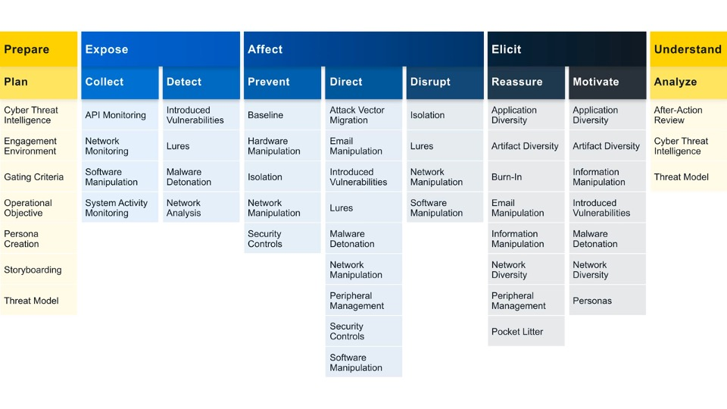
ENGAGE GOAL : EXPOSE
We can Expose adversaries on the network by using deceptive activities to provide high fidelity alerts when adversaries are active in the engagement environment.
Engage Approaches: Helps us to identify what actions we would like to take against our adversary and helps us to drive progress towards that impact.
The two engagement approaches under expose includes: COLLECT AND DETECT
COLLECT: Gather adversary tools, observe tactics, and collect other raw intelligence about the adversary’s activity.
DETECT: Establish or maintain awareness regarding adversary activity. Detection activities focus on the defender’s ability to monitor adversary activity throughout an environment, often by creating high-fidelity detections.

Slide 3
1. System Activity Monitoring Using Sysmon
Sysmon, short for System Monitor, is a powerful system monitoring tool for Linux operating systems that provides comprehensive insights into the system's performance, activities, and resource utilization.
It is designed to track and log various system activities, such as process creations, network connections, file creations, and more, enabling administrators to effectively monitor and analyze system behavior.
Sysmon offers a holistic view of the system's activities, helping users identify potential security threats, track down suspicious activities, and troubleshoot performance issues.
By capturing detailed information about system events, Sysmon plays a crucial role in enhancing the overall security posture and operational efficiency of Linux systems.
With its extensive logging capabilities, Sysmon serves as a valuable resource for detecting and analyzing security incidents and potential breaches. It enables system administrators and security professionals to monitor and audit critical system events in real-time,

Slide 4
2. NETWORK MONITORING AND ANALYSIS USING SURICATA
Reasons why Suricata is preferred more than Snort:
Multithreading Support:
Suricata is designed with native multithreading support, allowing it to efficiently utilize modern multi-core processors. This enables Suricata to handle a higher volume of network traffic and process multiple tasks concurrently, improving overall performance.
Snort, on the other hand, traditionally relies on a single-threaded architecture, which may limit its scalability on systems with multiple cores.
Logs can be integrated with Wazuh:
Suricata’s logs can be easily integrated with Wazuh and elastic search, hence it helps to monitor and analyze packets efficiently.
Restricted Alert Generation:
Snort was not able to generate many alerts in T-pot, especially for the alerts which I am going to cover in my further slides, so Suricata is efficient for network monitoring compared to Snort.
4. Protocol Detection and Parsing:
Suricata has enhanced protocol support and parsing capabilities, enabling it to detect and analyze a wide range of network protocols effectively. This is crucial for identifying sophisticated attacks that may involve multiple protocols or non-standard communication patterns.
Snort is proficient in protocol detection, but Suricata's extended protocol support provides an edge in certain complex network environments.

Slide 5
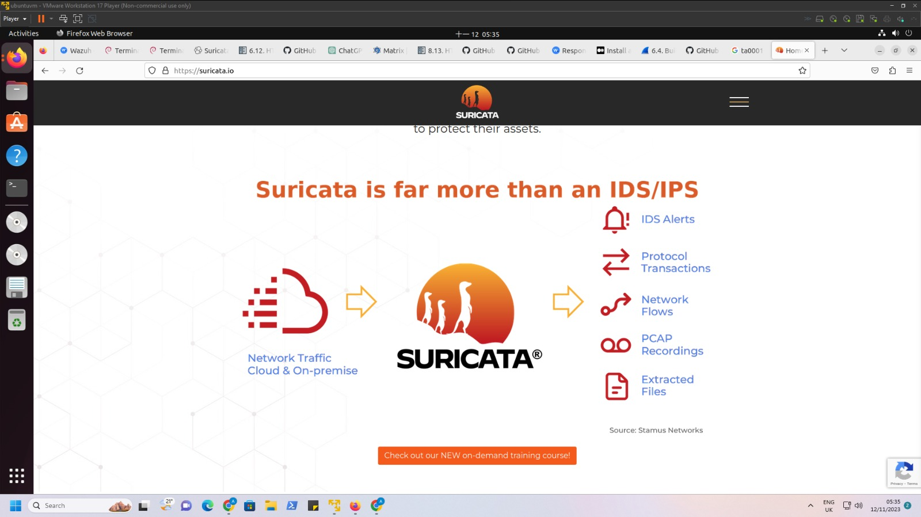
INTRODUCTION TO SURICATA
Suricata is a free and open-source threat detection engine. It does this by combining IDS,IPS, and network security monitoring.
Suricata is owned and developed by the community-run-non-profit organization OSIF(Open Information Security Foundation)
GitHub Repository: https://github.com/OSIF/suricata
Suricata serves as an Intrusion Detection System (IDS) and Intrusion Prevention System (IPS), helping organizations monitor and secure their network infrastructure.
Suricata has 2 main operational modes:
Active(IPS)- Used to alert, log and block network traffic that matches specific rules.
Passive(IDS)- Used to identify, alert and log suspicious network traffic within a network.

Slide 6
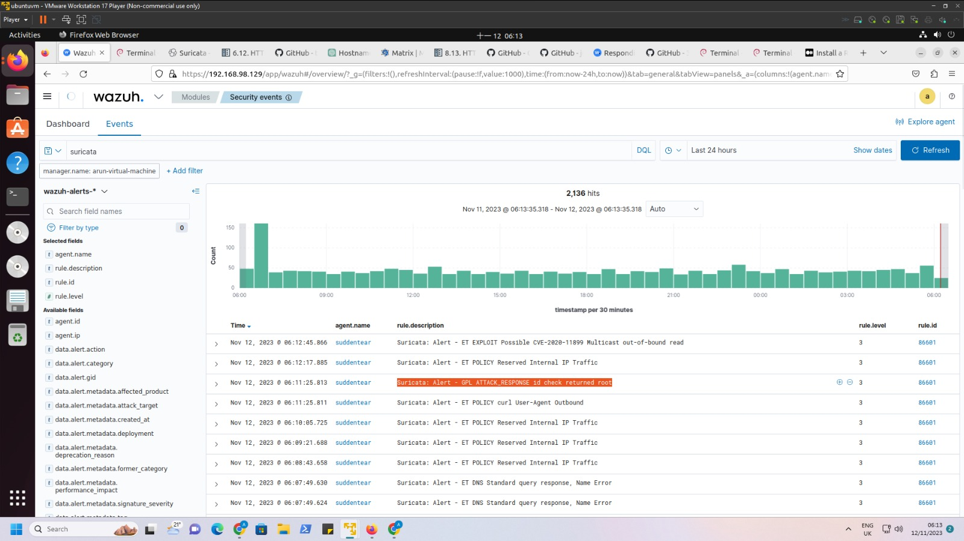
Integrated Suricata with Wazuh

Slide 7
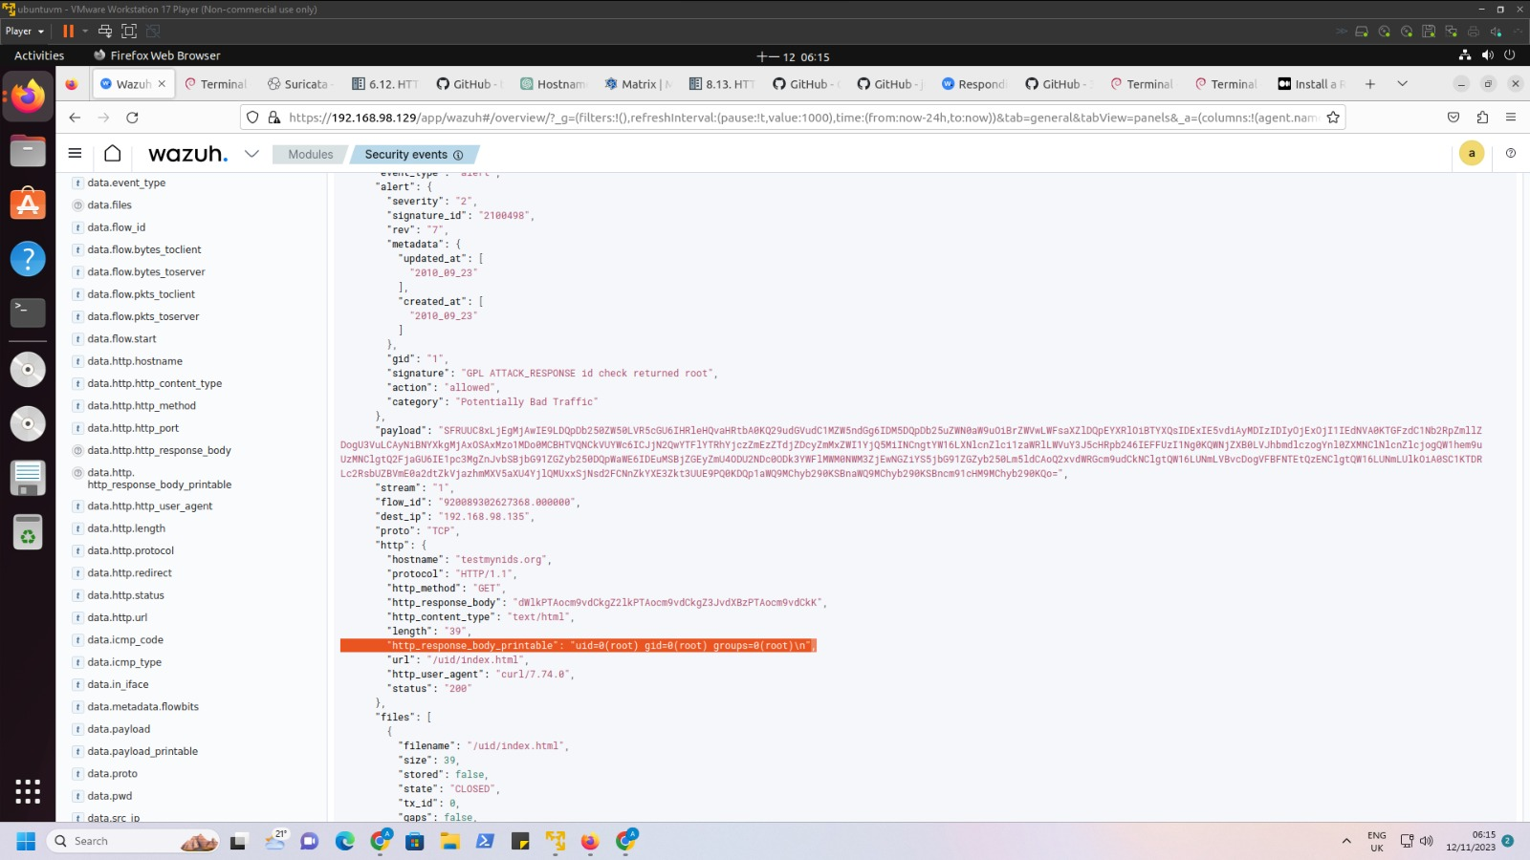
We can click on the alert generated and analyse the packets in a detailed way using Wazuh.

Slide 8
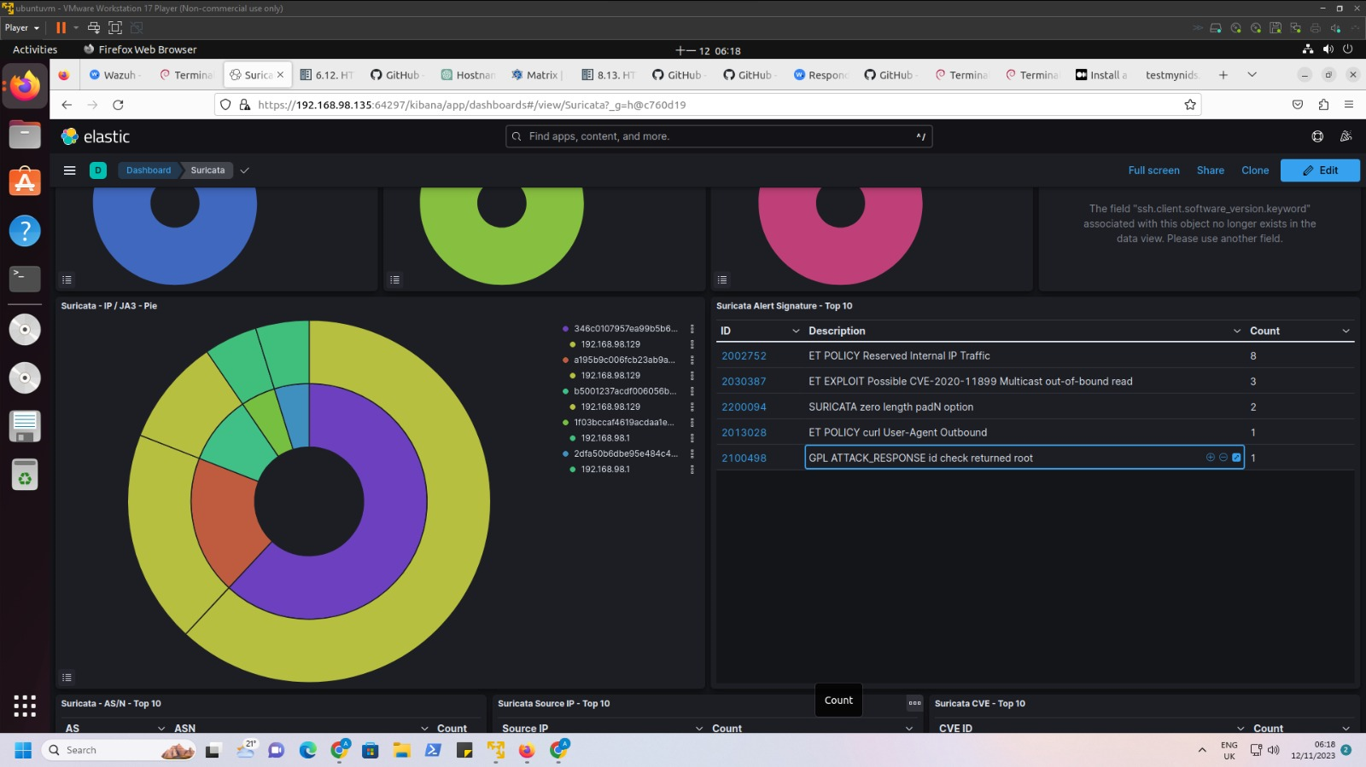
T-pot Elastic Search Dashboard

Slide 9
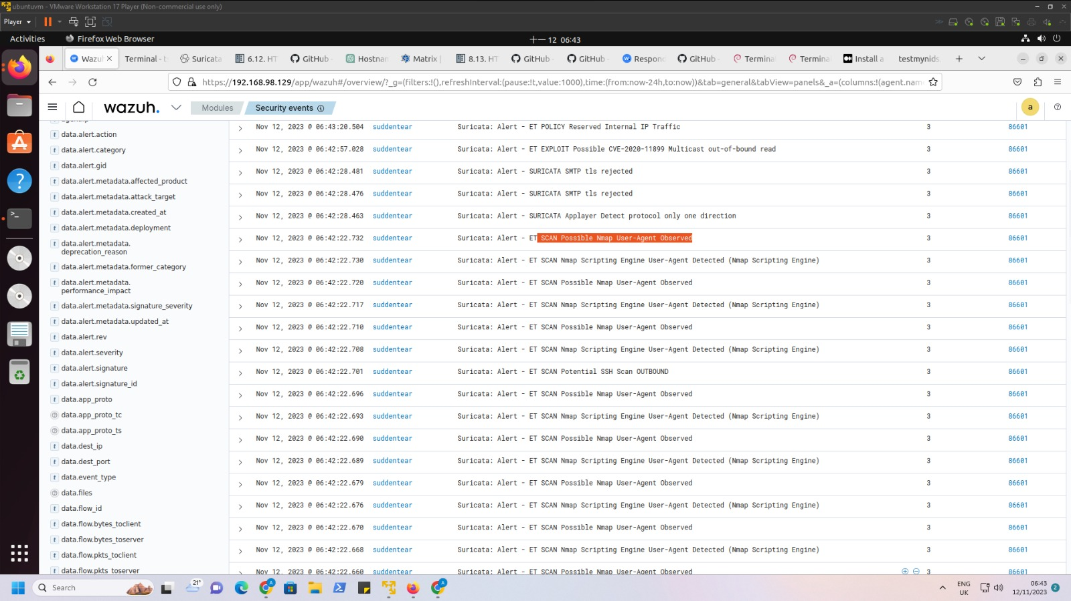

Slide 10
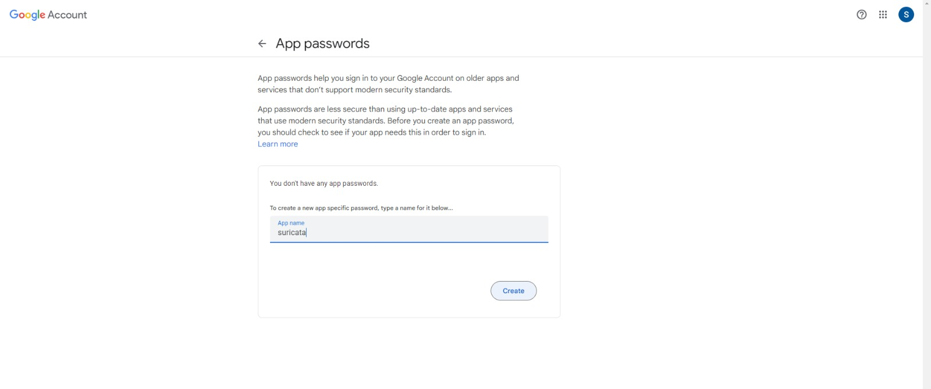
AUTOMATION OF EMAIL ALERTS FOR SURICATA
Step-1 : Using app passwords for email alert generation
Step-2 : Write a Python code for automation of email alerts

Slide 11
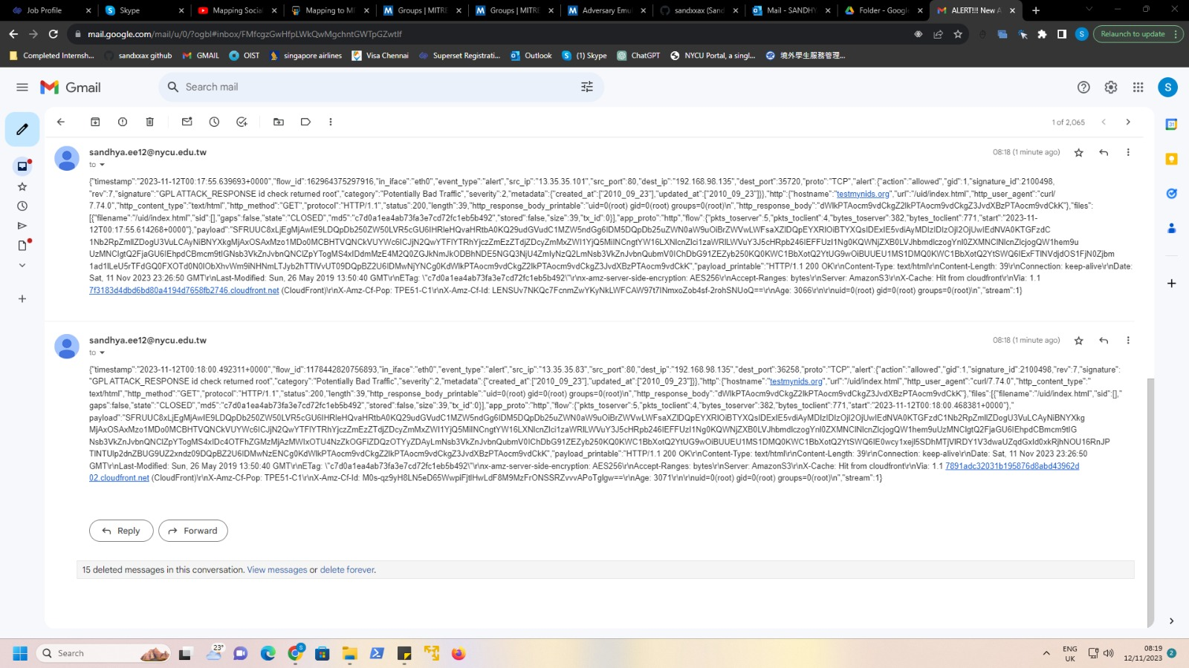

Slide 12

MALWARE DETECTION USING WAZUH
Malware, short for malicious software, refers to any software specifically designed to harm or exploit computer systems, networks, or users. It is created with the intention of gaining unauthorized access, causing damage, stealing sensitive information, or performing other malicious activities on a target system. There are various types of malware, each with specific functions and infection methods. Some common types of malware include viruses, worms, ransomware, botnets, spyware, trojans, and rootkits.
Malware detection is crucial for safeguarding computer systems and networks from cyber threats. It helps identify and mitigate malicious software that can cause a data breach, system compromise, and financial loss.
Malware detection refers to the process of analyzing a computer system or network for the existence of malicious software and files. Security products can identify malware by checking for signatures of known malware. Security tools can also detect malicious activity by detecting suspicious behavior from software activity. When malware infects a system, it can modify itself using various techniques to evade detection.
The Wazuh file integrity monitoring (FIM) module helps detecting malicious files on monitored endpoints. On its own, the FIM module cannot detect malicious files. However, you can detect malware by combining the FIM module with threat detection rules and threat intelligence sources. You can configure Wazuh to use FIM events with threat intelligence sources like VirusTotal and YARA scans to detect malware.

Slide 13

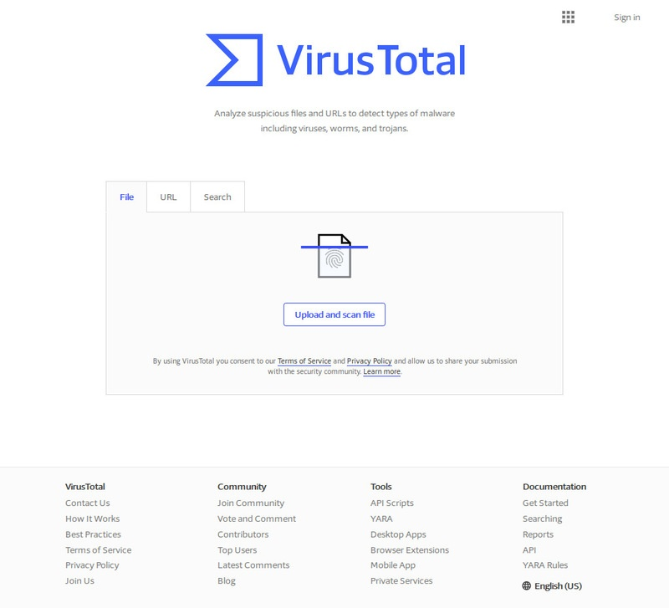
VIRUS TOTAL INTEGRATION WITH WAZUH
Wazuh detects malicious files through an integration with VirusTotal, a powerful platform aggregating multiple antivirus products and an online scanning engine.
Combining this tool with our FIM module provides an effective way of inspecting monitored files for malicious content.
VirusTotal is an online service that analyzes files and URLs to detect viruses, worms, trojans, and other malicious content using antivirus engines and website scanners.
VirusTotal is a free service with numerous useful features such as:
VirusTotal stores all the analyses it performs, allowing users to search for file hashes. By sending the hash to the VirusTotal engine, we can know if VirusTotal has already scanned that specific file, and we can analyze its report.
VirusTotal also provides an API that allows us to access the information generated by VirusTotal without needing to utilize the HTML website interface.

Slide 14

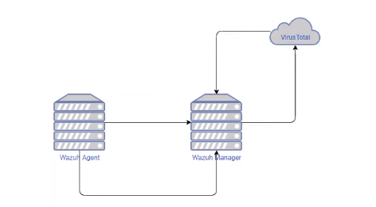
HOW IT WORKS?
This integration uses the VirusTotal API to detect malicious content within the files and directories monitored by the File Integrity Monitoring capability of Wazuh. This integration functions as described below:
Wazuh FIM looks for any file addition, change, or deletion on the monitored folders. This module has the hash of these files stored and triggers alerts when it detects any changes.
If enabled, Wazuh triggers the VirusTotal integration when an FIM alert occurs. From this alert, the integration extracts the hash field of the file.
The integration then makes an HTTP POST request to the VirusTotal database using the VirusTotal API. This call sends the extracted file hash to compare it with the information in the VirusTotal database.
The integration receives a JSON response, which is the result of the request. The response triggers the Wazuh alerts.
Wazuh logs the triggered alert in the /var/ossec/logs/integration.log file and stores it in the /var/ossec/logs/alerts.log file with all other alerts.
When a file is added to the server, Wazuh agent will scan that file with the syscheck daemon and generate a hash. After generating hash it is going to forward it to Wazuh manager. Now Wazuh manager will send the new hash to the Virus Total .Virus Total gives us the ability with its free API to submit the hashes to their platform for analysis. After analyzing the hash, Virus Total sends the results to the Wazuh Manager and alerts can be generated.

Slide 15
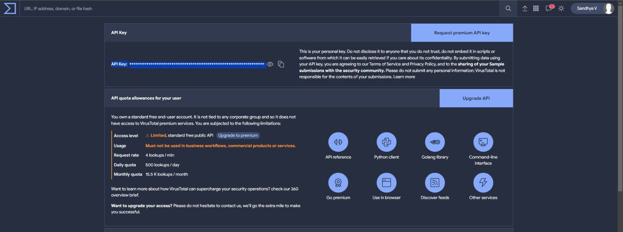
Detecting and removing malware using VirusTotal integration
We can use the Wazuh File Integrity Monitoring (FIM) module to monitor a directory for changes and the VirusTotal API to scan the files in the directory. Then, configure Wazuh to trigger an active response script and remove files that VirusTotal detects as malicious.
We need a VirusTotal API key in this use case to authenticate Wazuh to the VirusTotal API.

Slide 16
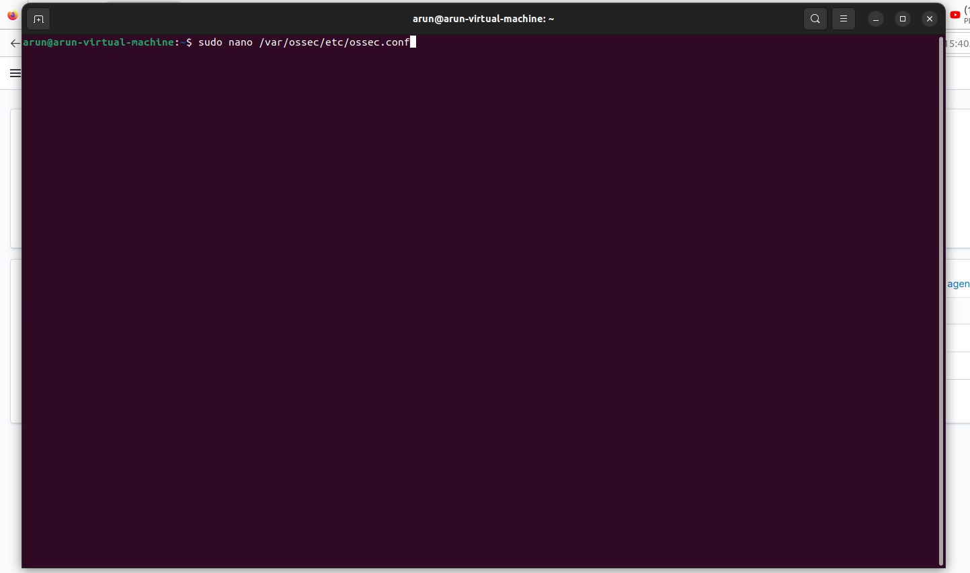
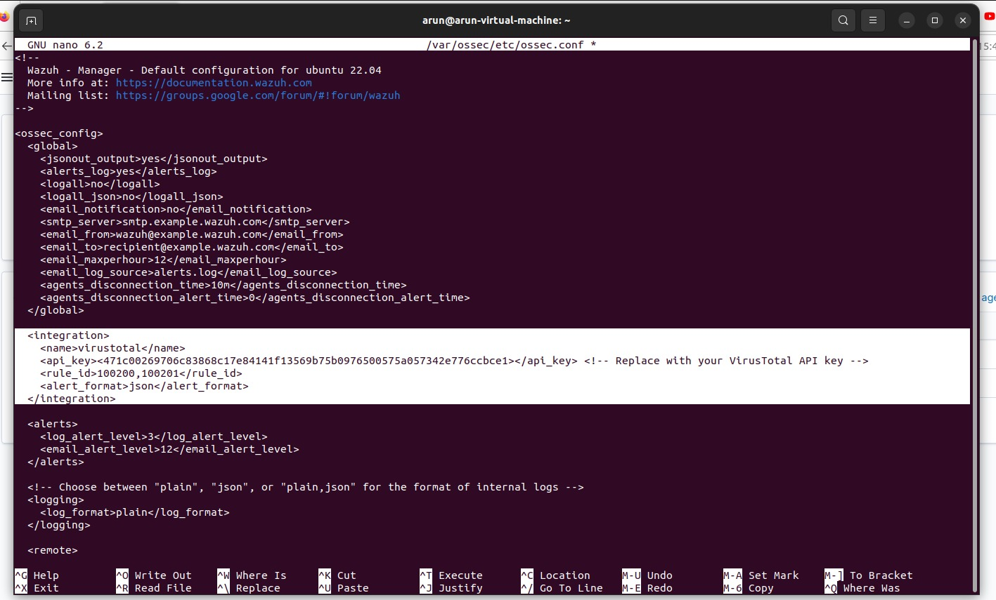
INTEGRATION OF VIRUS TOTAL
STEP-1: Enable the Integrator module and configure the VirusTotal integration.

Slide 17
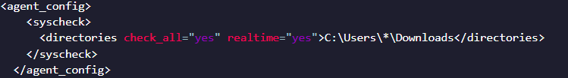
STEP-2 : Using FIM to monitor a directory
Add the following to the <syscheck> section of the configuration file. We can configure these options in the Wazuh server and the Wazuh agent /var/ossec/etc/ossec.conf file. You can also configure this capability remotely using the centralized configuration options provided by the agent.conf file. In our case we have configured the options on the Wazuh server.
STEP-3 : Install jq, a utility that processes JSON input from the active response script.
sudo apt update
sudo apt -y install jq
STEP-4 : Create the /var/ossec/active-response/bin/remove-threat.sh active response script to remove malicious files from the endpoint
STEP-5 :Change the /var/ossec/active-response/bin/remove-threat.sh file ownership, and permissions:
sudo chmod 750 /var/ossec/active-response/bin/remove-threat.sh
sudo chown root:wazuh /var/ossec/active-response/bin/remove-threat.sh
STEP-6 : Restart the Wazuh agent to apply the changes:
sudo systemctl restart wazuh-agent
After restarting, FIM applies the new configuration and monitors the folder we specify in near real time. When FIM detects a new file in the monitored directory, Wazuh generates the alerts.

Slide 18
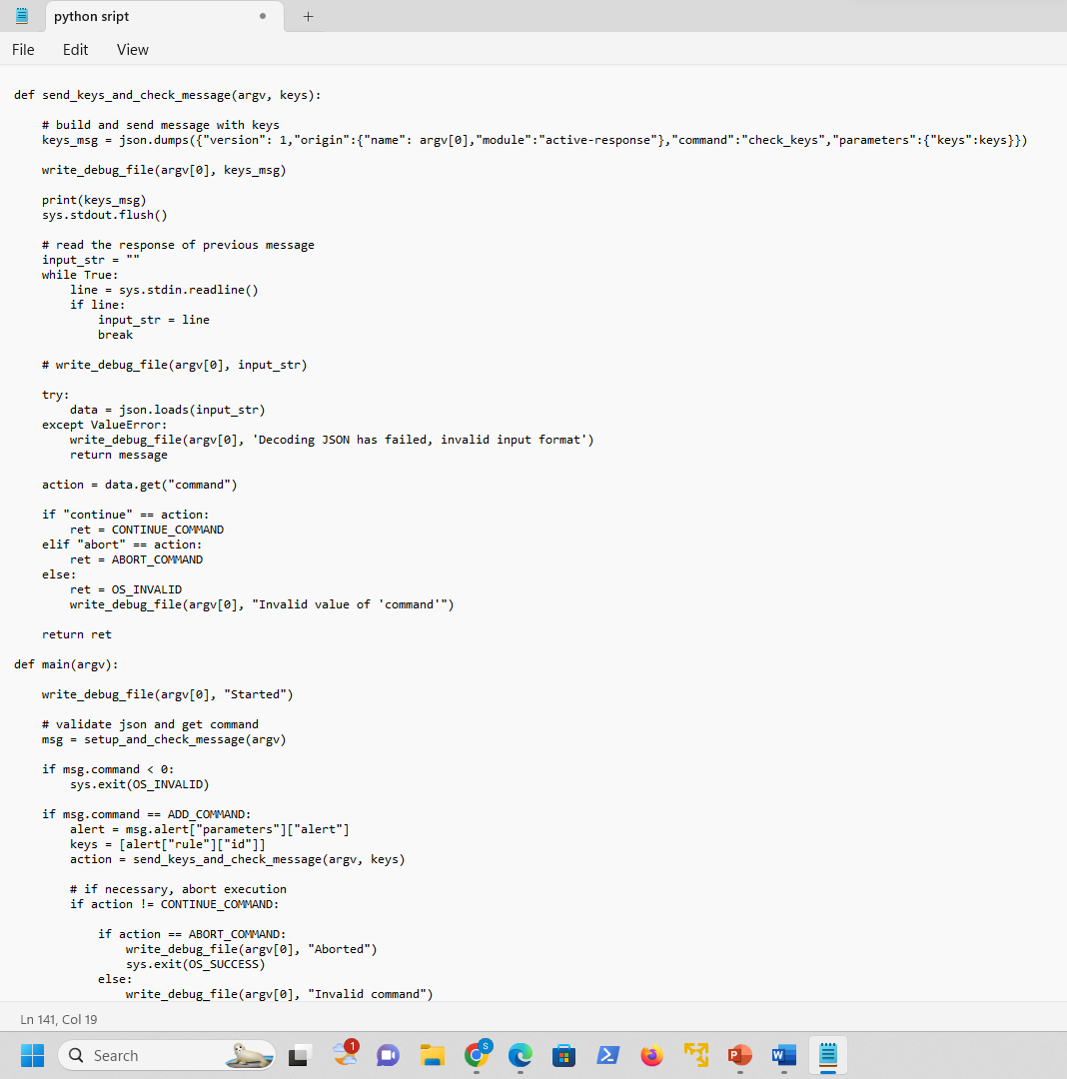
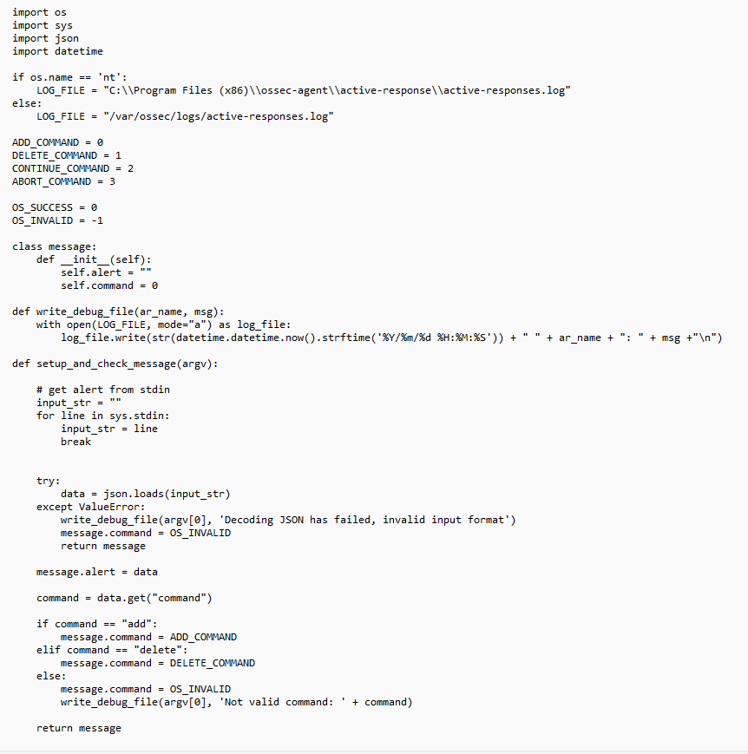
STEP-4: Python Script- To remove malicious threat files

Slide 19
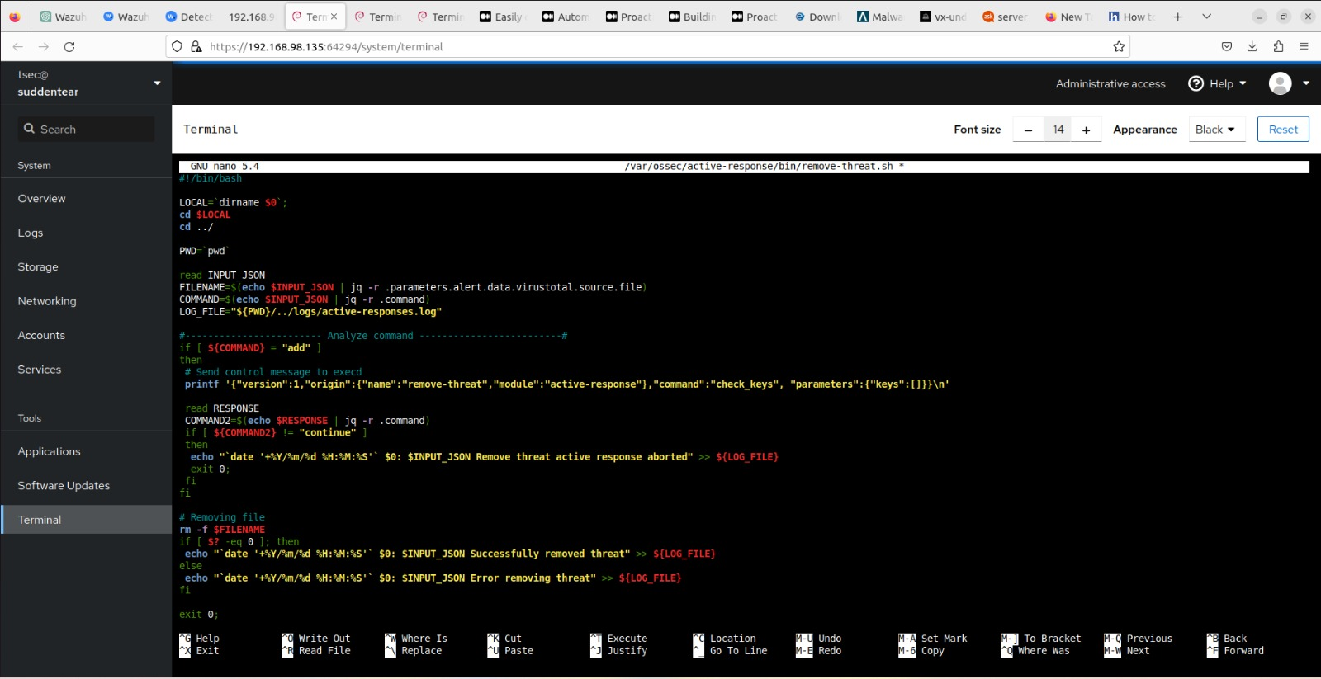

Slide 20
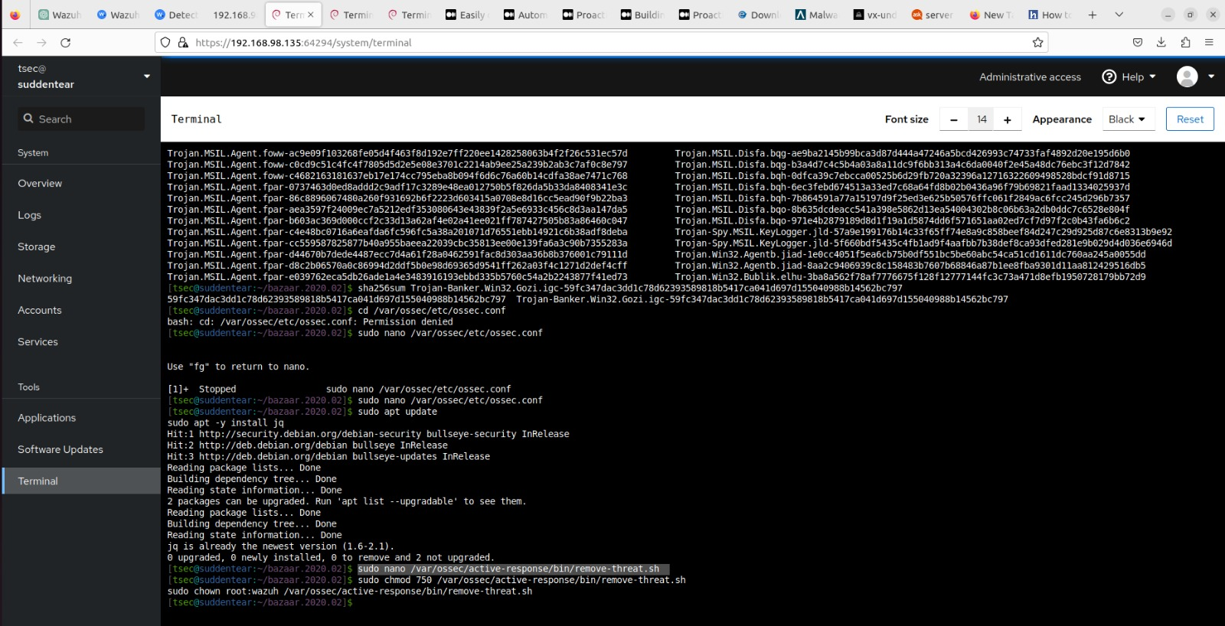

Slide 21
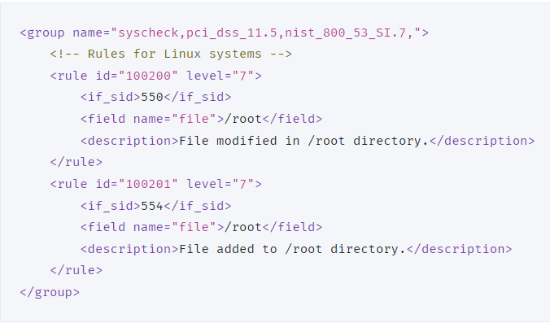
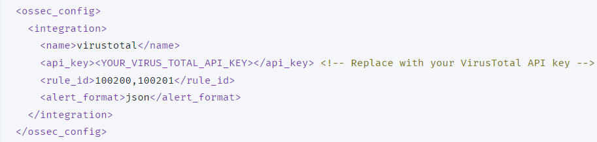
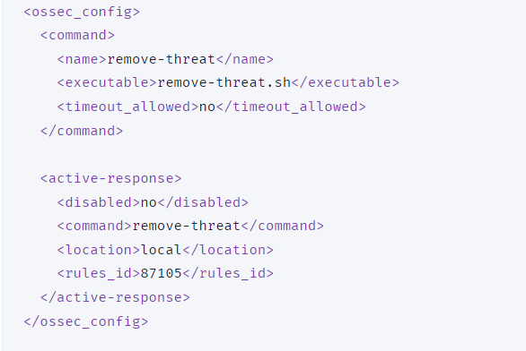
NEXT CONFIGURATION- WAZUH SERVER
We need to perform the following steps on the Wazuh server to alert for changes in the endpoint directory and enable the VirusTotal integration. These steps also enable and trigger the active response script whenever a suspicious file is detected.
Add the following rules to the /var/ossec/etc/rules/local_rules.xml file on the Wazuh server. These rules alert about changes in the /root directory that are detected by FIM scans: ------→
Add the following configuration to the Wazuh server /var/ossec/etc/ossec.conf file to enable the Virustotal integration. Replace <OUR_VIRUS_TOTAL_API_KEY> with our VirusTotal API key. This allows to trigger a VirusTotal query whenever any of the rules 100200 and 100201 are triggered: ------→
Append the following blocks to the Wazuh server /var/ossec/etc/ossec.conf file. This enables active response and triggers the remove-threat.sh script when VirusTotal flags a file as malicious: ------→

Slide 22
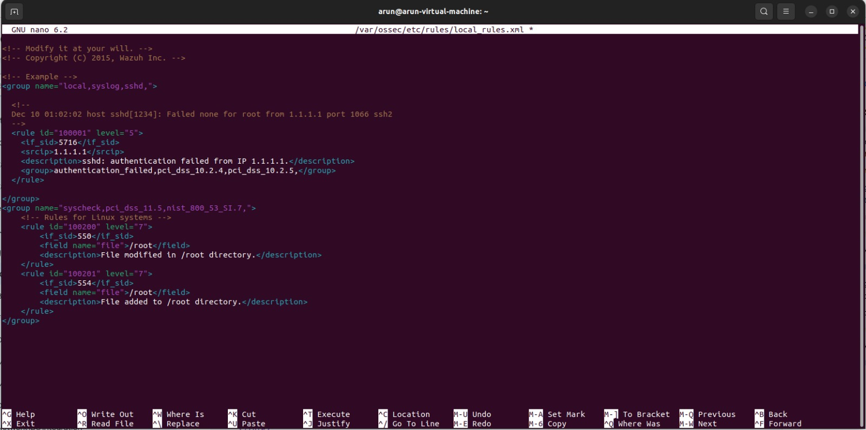

Slide 23
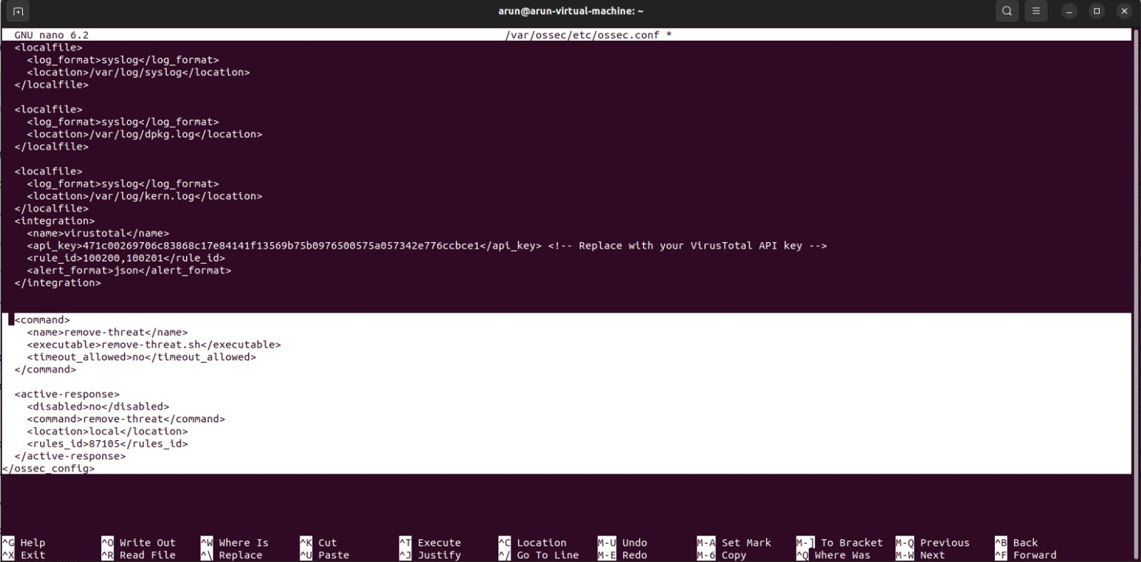

Slide 24
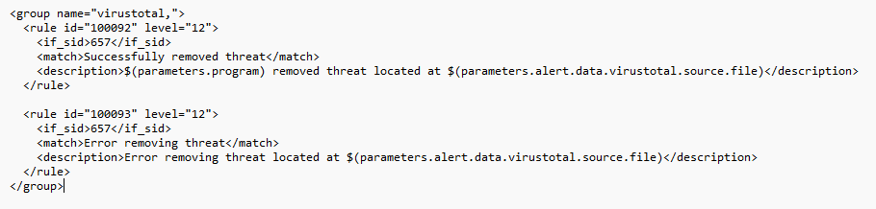

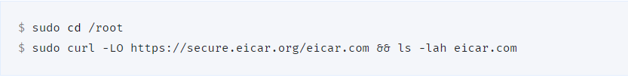
4. Add the following rules to the Wazuh server /var/ossec/etc/rules/local_rules.xml file to alert about the active response results:
5. Restart the Wazuh manager to apply the configuration changes:
ATTACK EMULATION
Download an EICAR test file to the /root directory on the Ubuntu endpoint:
2. Visualize the alerts!!!

Slide 25
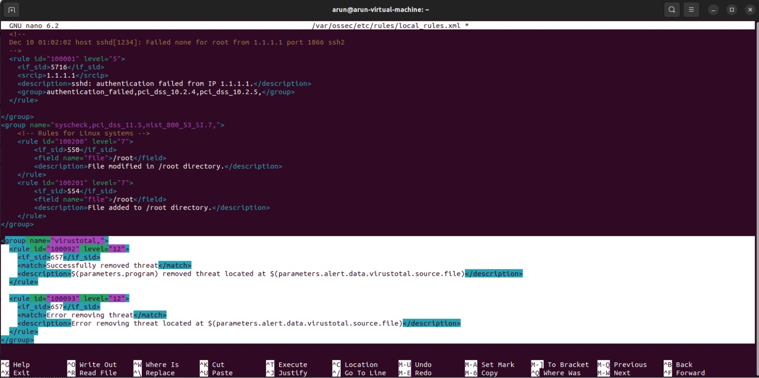

Slide 26
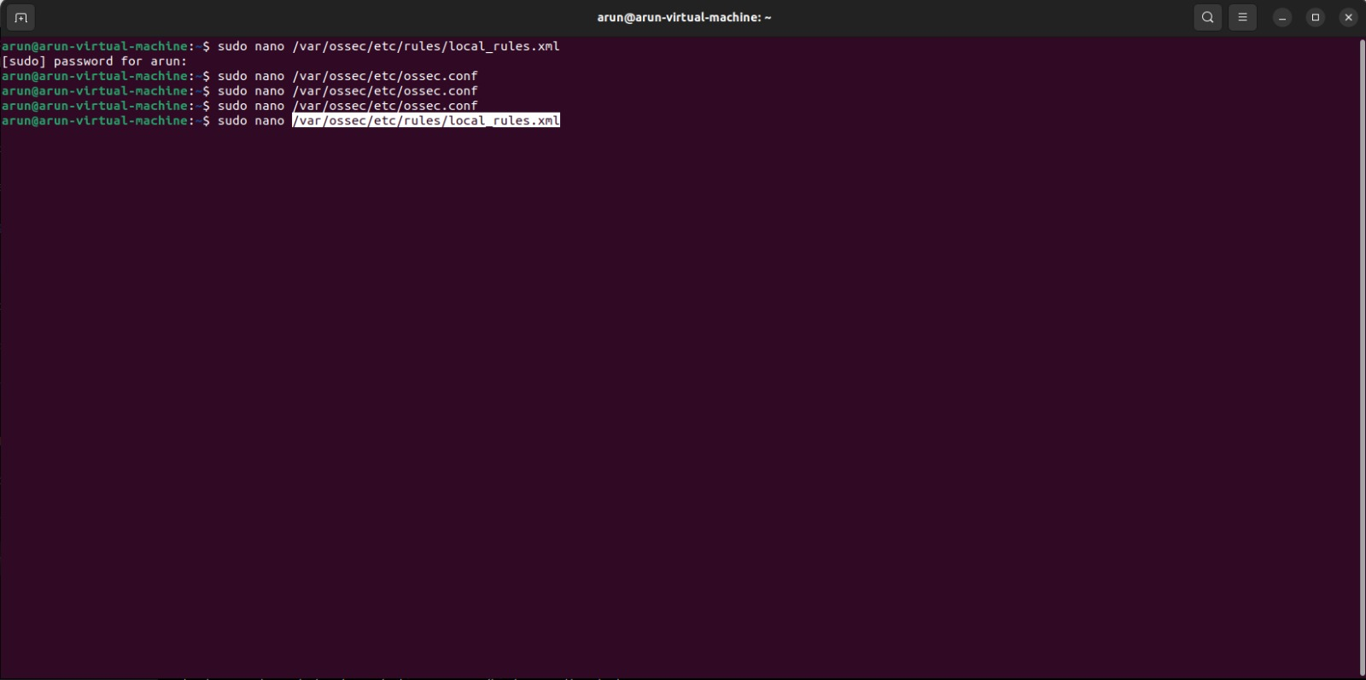
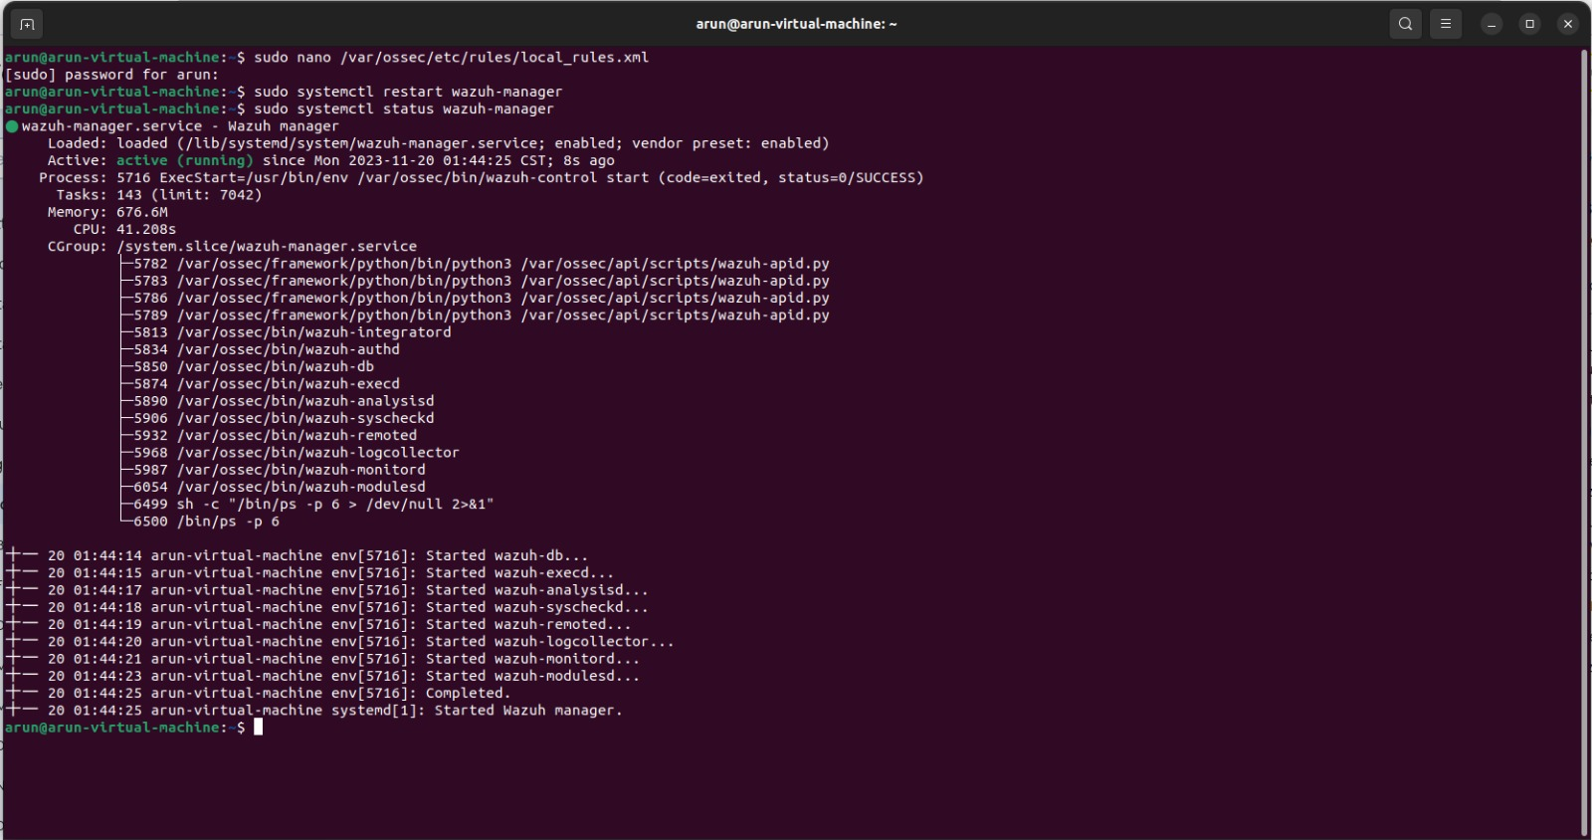

Slide 27
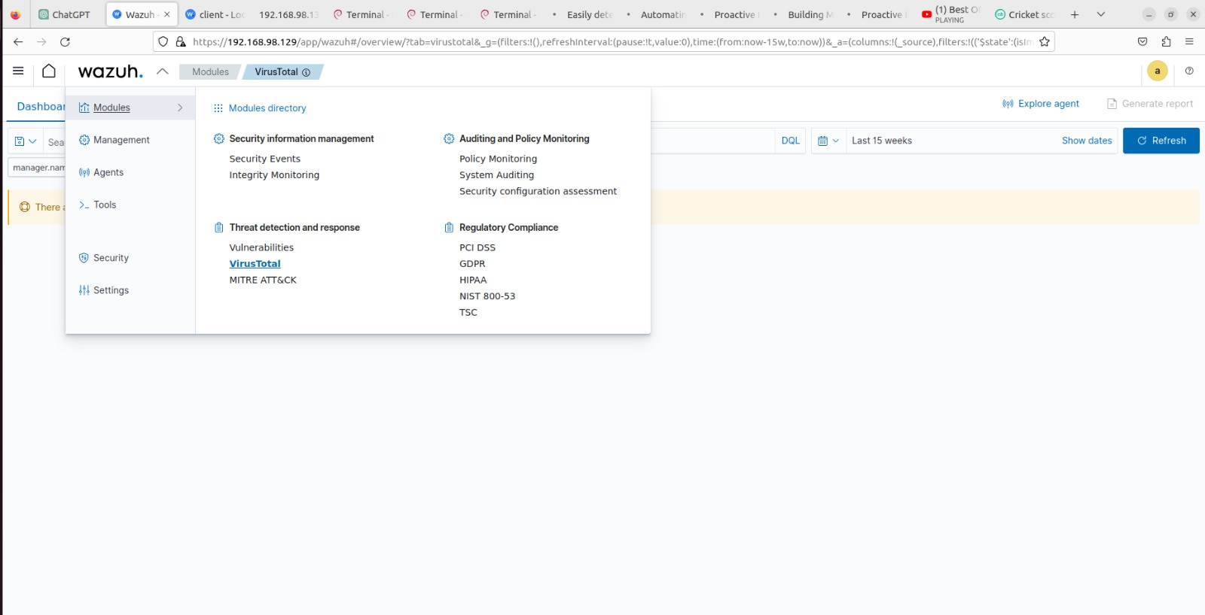
CONFIGURE IN WAZUH

Slide 28
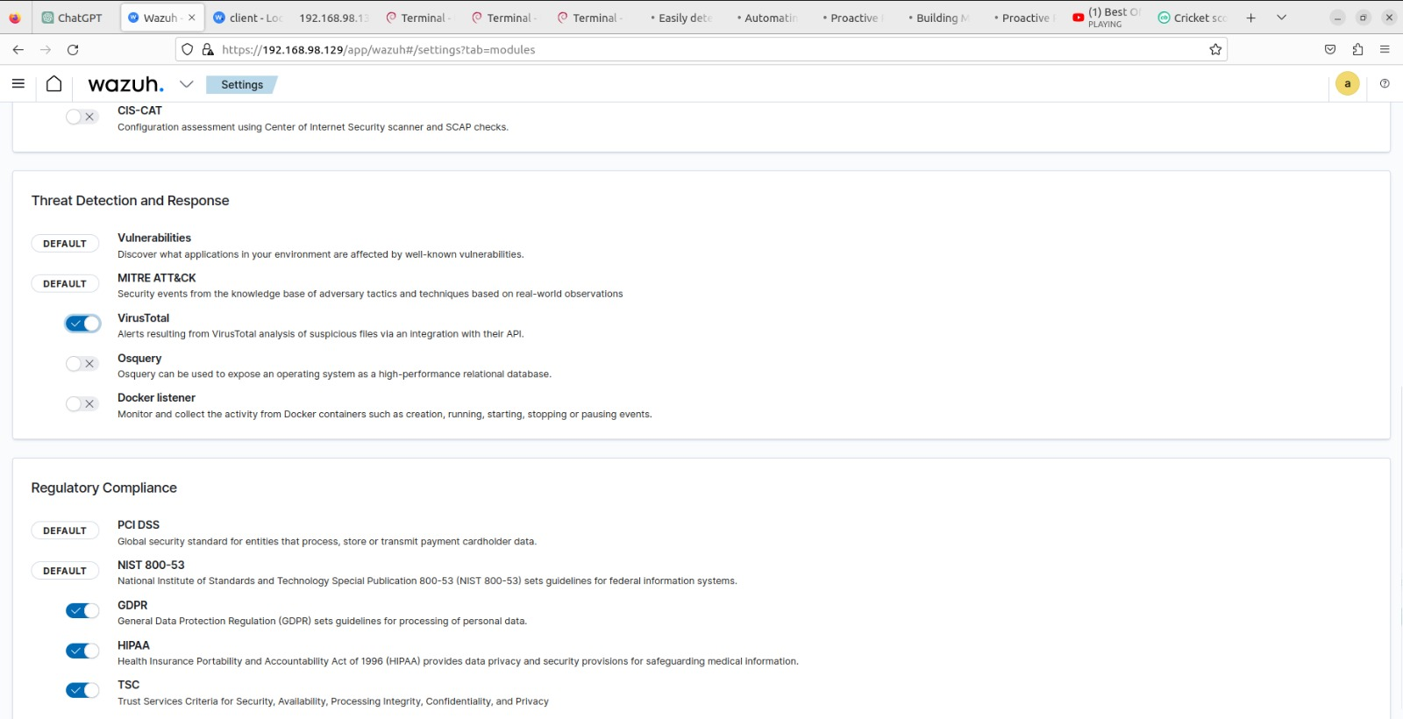

Slide 29
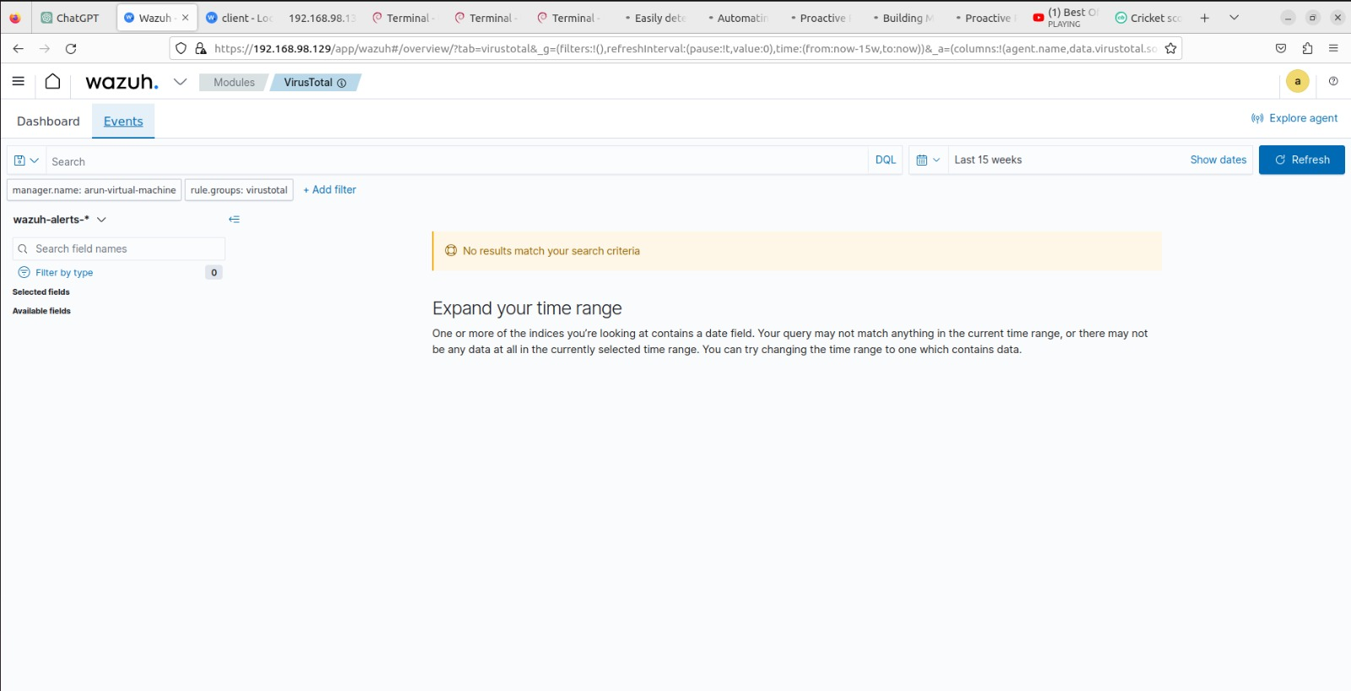
No Malware files are there under logs section!!

Slide 30
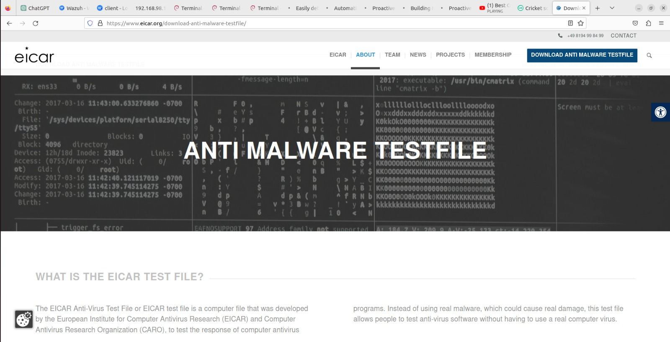

Slide 31
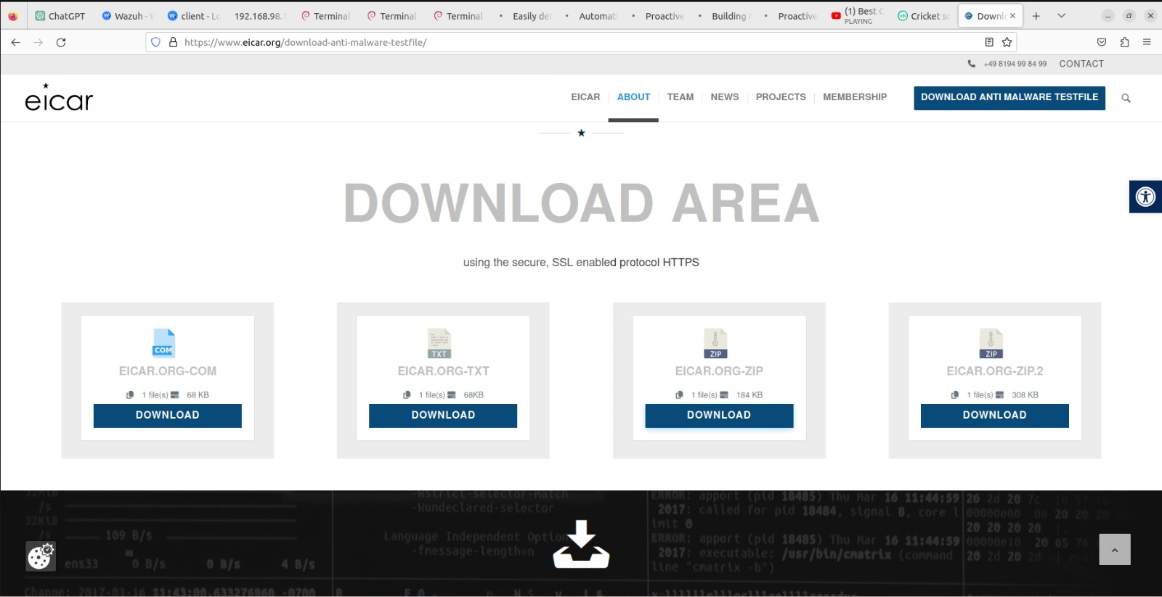

Slide 32
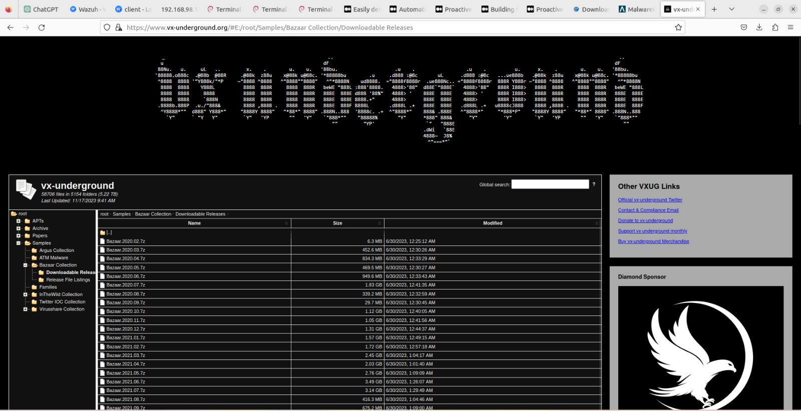

Slide 33
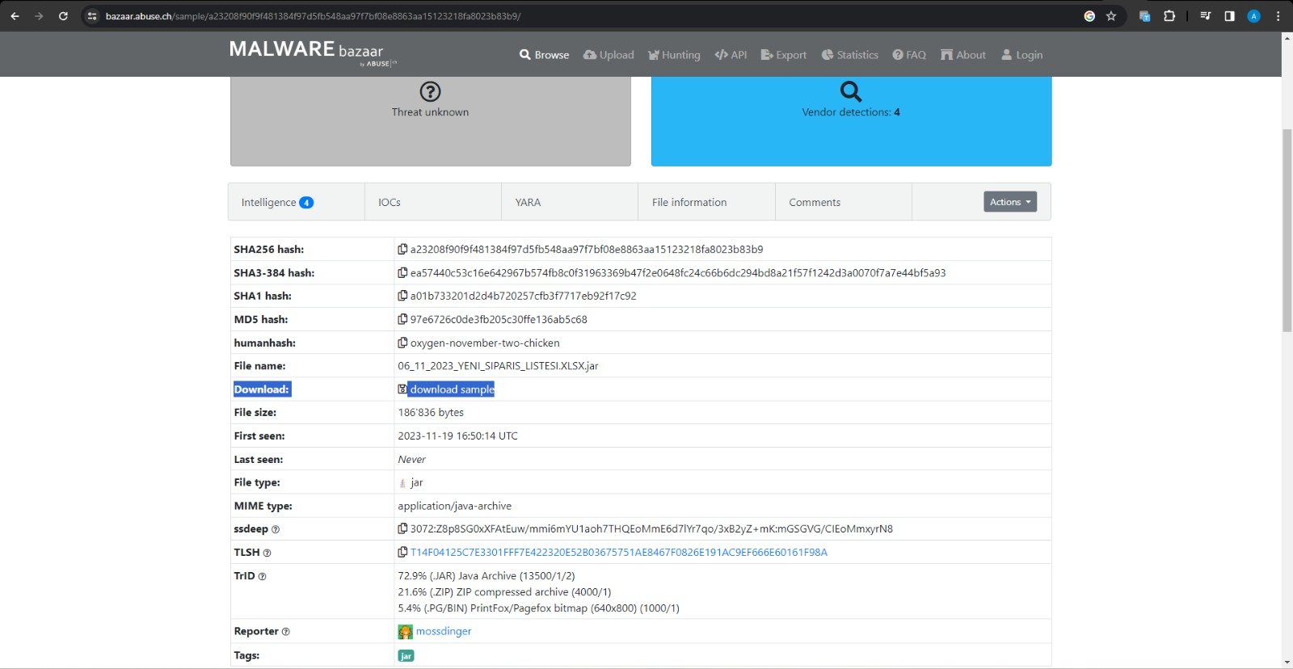

Slide 34
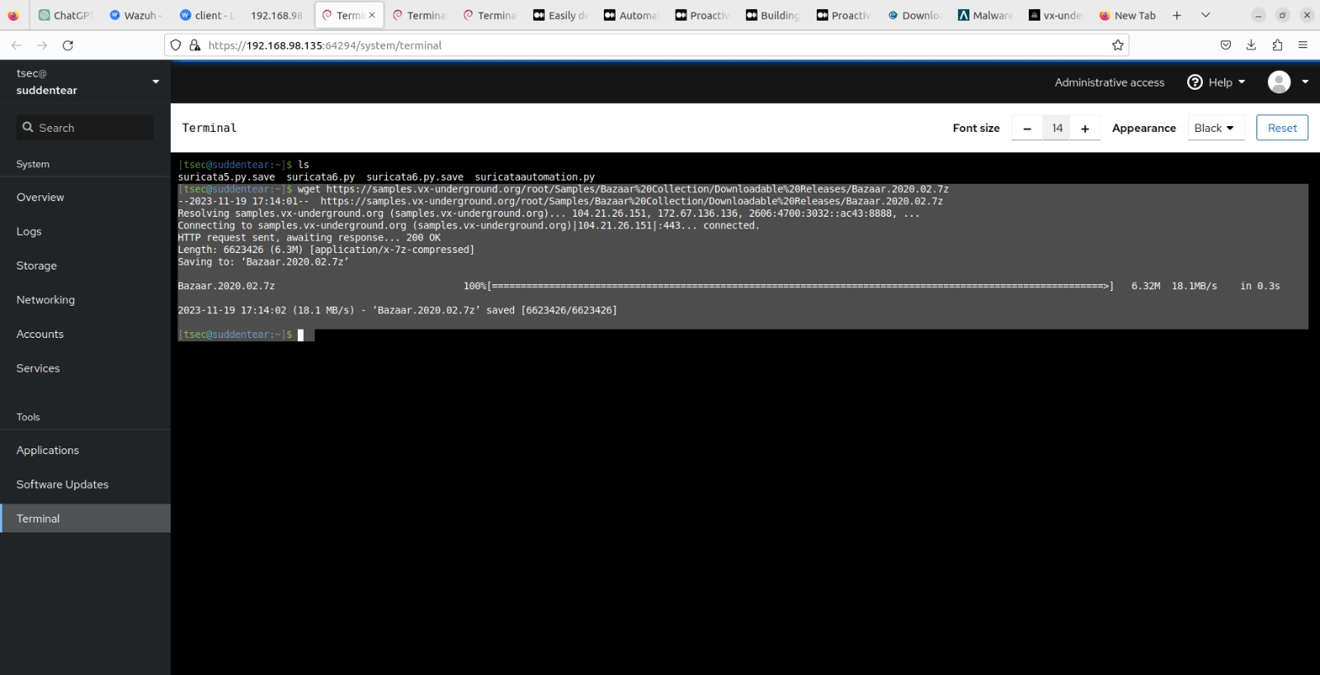

Slide 35
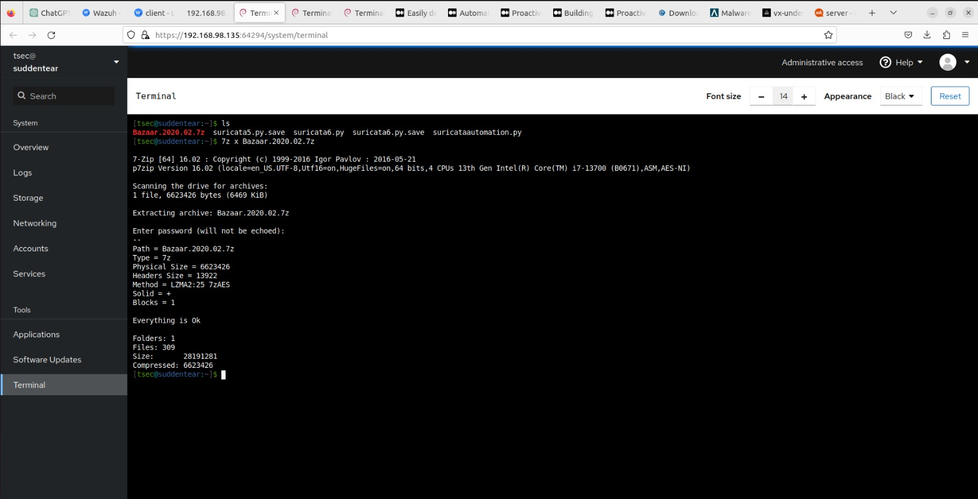
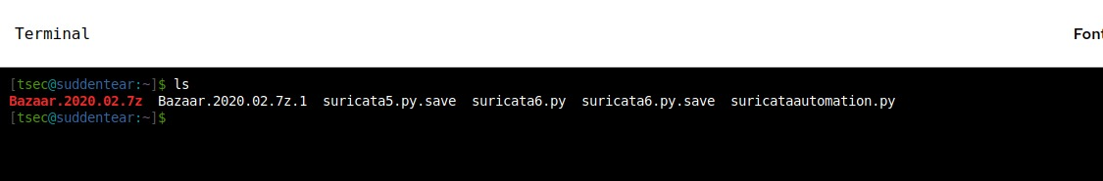

Slide 36
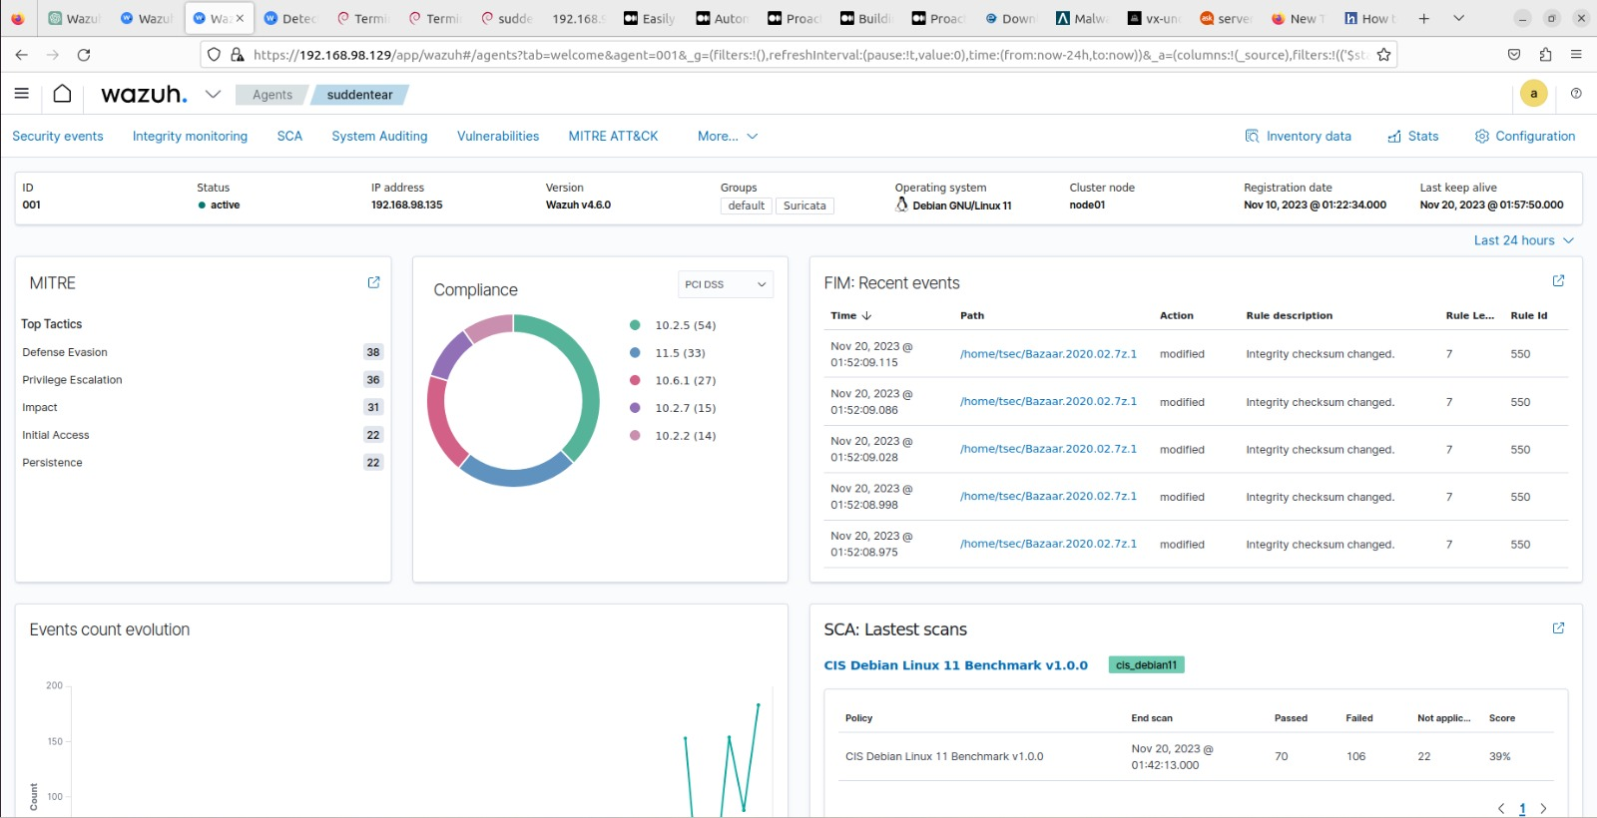

Slide 37
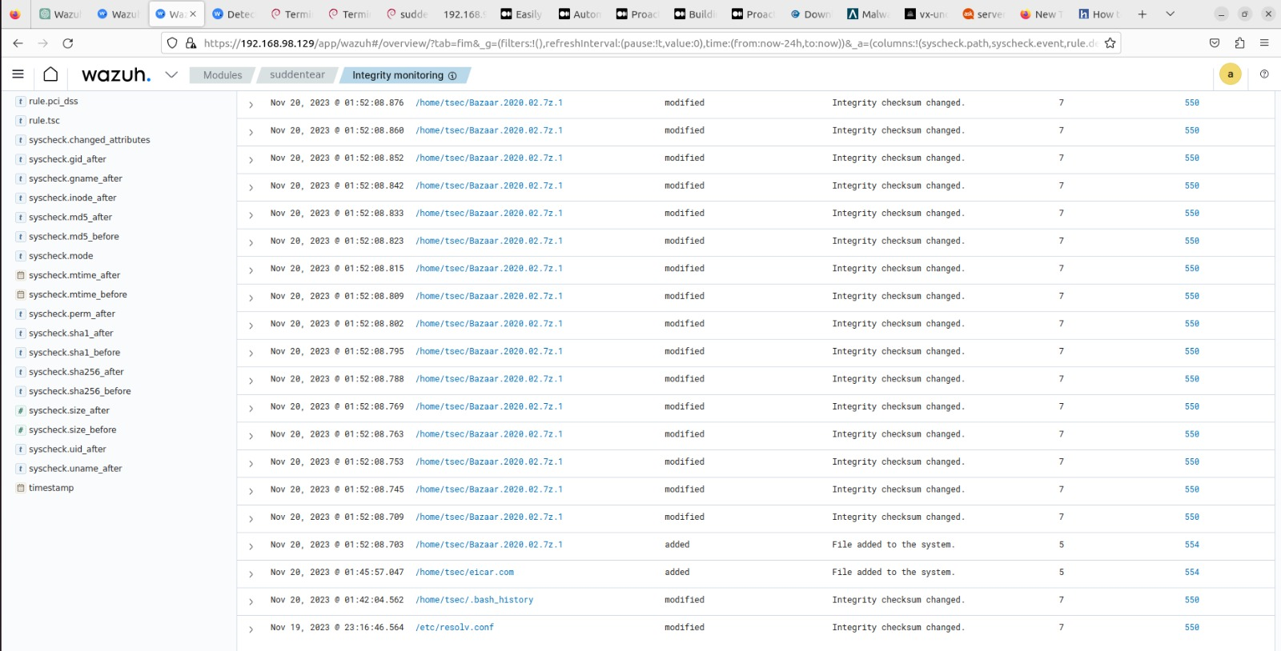

Slide 38
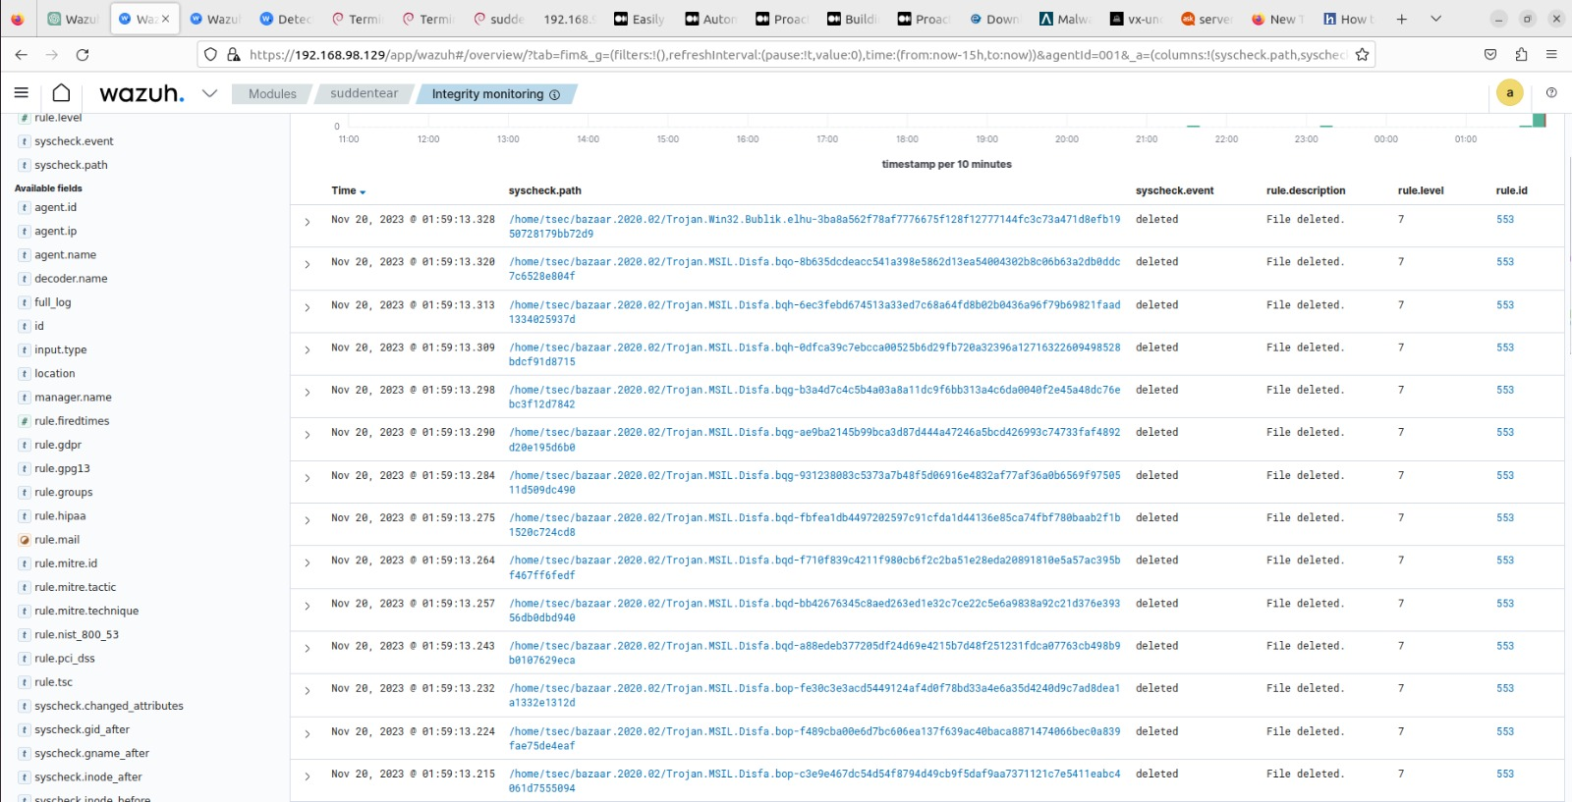

Slide 39
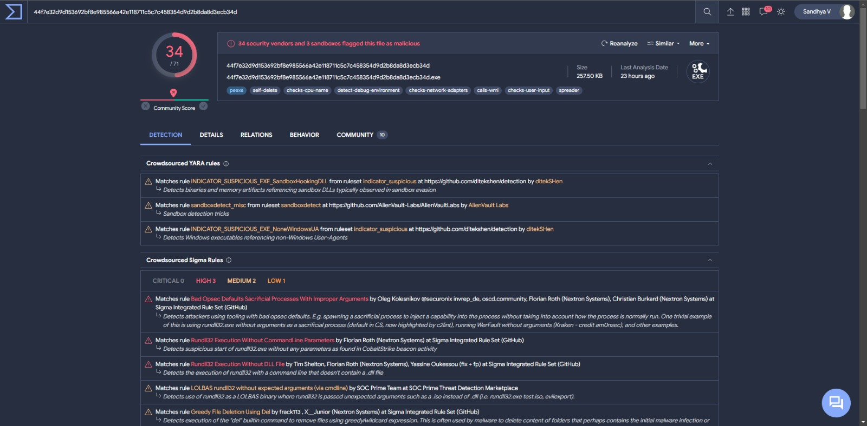

Slide 40
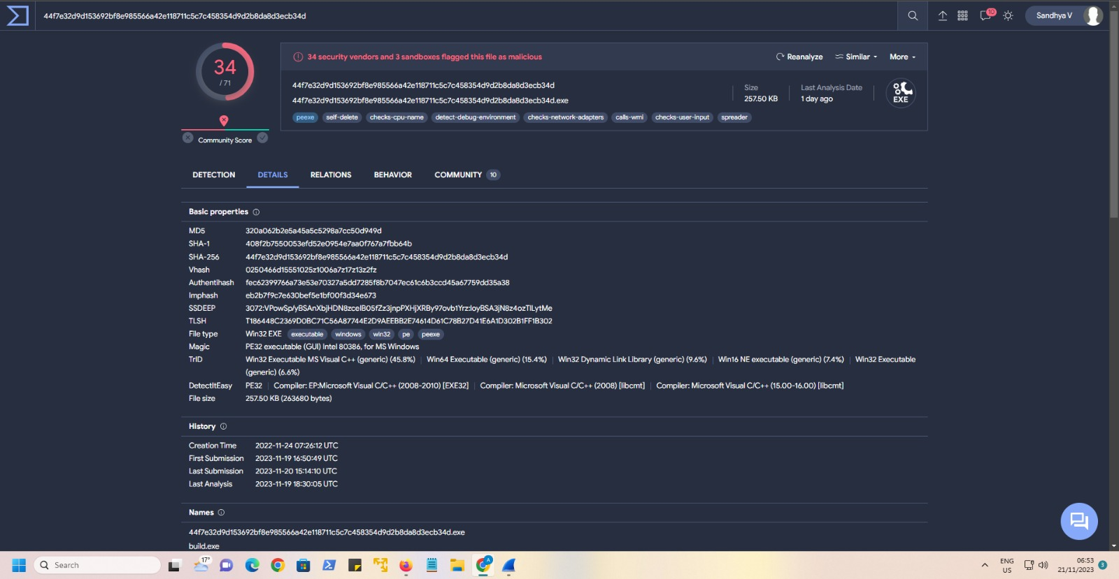

Slide 41


